Slide 1
Data Model for Cadaster Mapping

Slide 2


Slide 3
Project objectives/outcomes
Designing the conceptual model
Development of cataloging and mapping application
Validation of model database developed for managing cadaster data

Slide 4
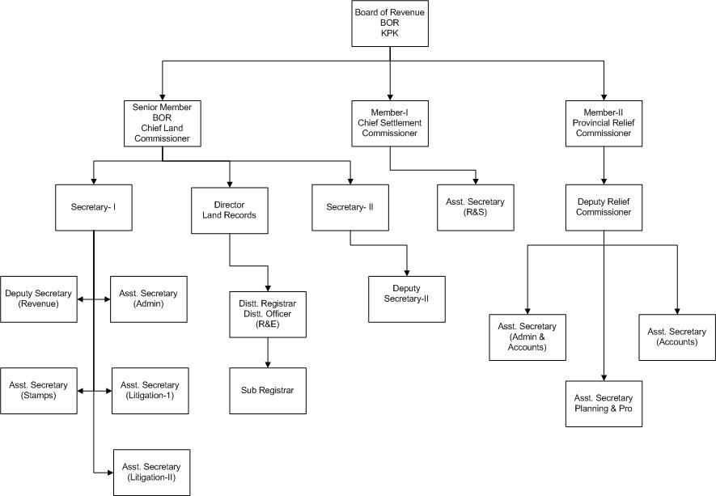
Revenue Administrative Hierarchy

Slide 5
Data Modelling
Land Records Registers

Slide 6
Type of Land Records
Mussavi (Cadastre Map)
Map of village/Moza on scale
Field Book
Contains the details of measurement of each field e.g. its length, breadth, diagonal detail, and worked out total area
Shajra Kishtwar
Sektch of village on a cloth (lattha) for day to day use
Register Haqdaran-e-Zamin
Contains necessary particulars about ownership, tenancy, khasra number and its classification, source of irrigation, land revenue, and Rent (Lagan).
Register of Mutation
Contains particulars of all transactions which are entered by the Patwari and decided by the Revenue Officer.

Slide 7
Type of Land Records
Register Khasra Girdawari
Contains details of the inspection of crop grown in each field in each harvest and all changes of ownership and tenancy
Lal Kitab (Village Note Book)
statistical book of a village
.total area, area sown, assessment of land revenue, number of entered and attested mutations, notes about changes in cultivation, and ownership for the last four years. It also shows the population of a village and the approximate number of livestock.
FARD BACH
Demand of land revenue there on recoverable from each land owner in a village.

Slide 8
List of Land Record Registers (Patwari Basta)
Register Haqdaraan-e-Zamin
Shajrah-e-Nasab
Index Survey / Khasra Number
Register Intiqaalat
Fard Badr
Register Gardawari
Field Book
Register Tagayarat-e-Kasht
Wajib-Ul-Arz
Index Radeef-Var-Malikan
Note Partaal Kanungo
Note Partaal Revenue Officer
Certificate last Attestation
Roznamcha Waqaati
Roznamcha Karguzari
Roznamcha Hidayati
Roznamcha Partal
Roznamcha Service Center (Service Center Register)
Reporting & Printing Gardawari
Reporting & Printing Shajra Nasab
Reporting & Printing Haqdaran-e-Zamin
Reporting & Printing Intiqaalat
Reporting & Printing Field Book
Reporting & Printing Wajb ul Arz

Slide 9
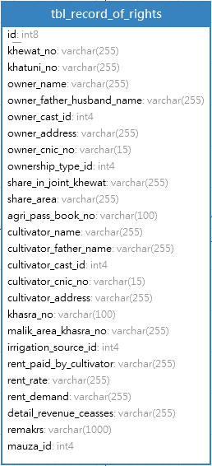
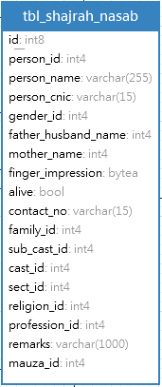
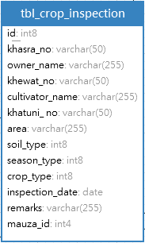
Layout of Registers
Register Girdawari
Register Haqdaraan-e-Zamin
Register Record of Rights

Slide 10
Cadaster Data Model (V1.0)
Click above link to view Data Model in PDF

Slide 11
Territory ID Structure
Territory ID Structure (01050122300503)
Province | Division | District | Tehsil | Urban/ Rural | Patwar Circle | Mouza | UC (Optional)
1 | 2 | 3 | 4 | 5 | 6 | 7 | 8
01 | 05 | 012 | 23 | 0 | 05 | 03 | 00
Province | Division | District | Tehsil | Urban/ Rural | Patwar Circle | Mouza | Town/ Cantt., Cooperative, Authority
1 | 2 | 3 | 4 | 5 | 6 | 7 | 8
01 | 05 | 012 | 23 | 1 | 05 | 03 | 02
Parcel ID is composite key which consist of two candidate keys

Slide 12

Process Modeling
Registry and Cadaster Processes

Slide 13
Land Process
Fard Malkiyat (Ownership Document) Process
Process of creating ownership document from the Haqdaran Zameen and Mutation.
Register Haqdaran Zamin (Land Registration) Process
Process of creating register Haqdaran Zamin also know as Jamabandi or Consolidation. This process should repeat every four year for reconilition of changes on land.
Fard Badar (Error Correction) Process
Process of correct error in different process and register including ownership, mutation, and mesurements.

Slide 14
Land Process
Gardawari (Binomial Inspection) Process
The process to collect crop yield information. This process repeated before every harvesting.
Mutation Process
Process of recording changes on landThere are various types of mutations such as sale, gift, mortgaging, lease, and subdivision, and devolution of land.

Slide 15
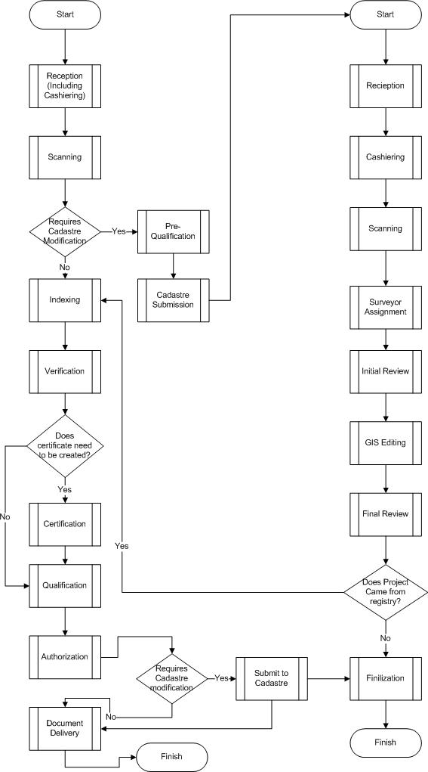
Registry
and
Cadastre
Process
Work flow

Slide 16
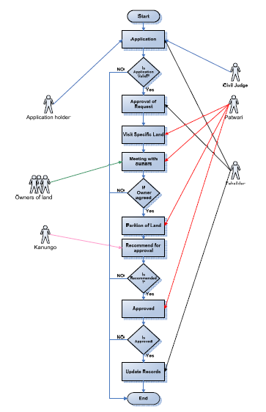
Land Registration Process

Slide 17
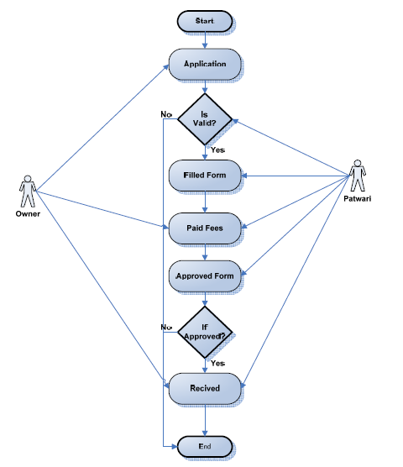
Fard Malkiyat (Ownership) Process

Slide 18
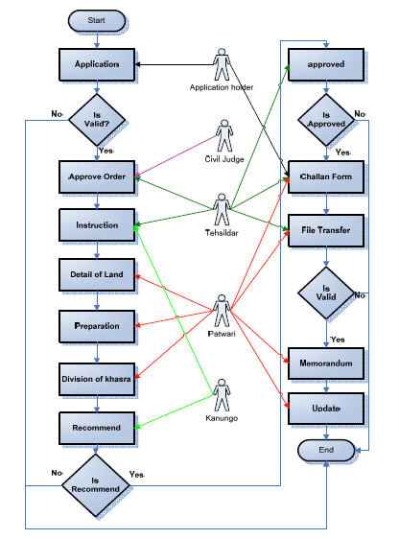
Mutation Process

Slide 19
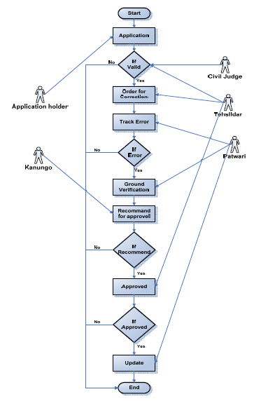
Error Correction Process

Slide 20
Thank You
Questions?

